Slide 1
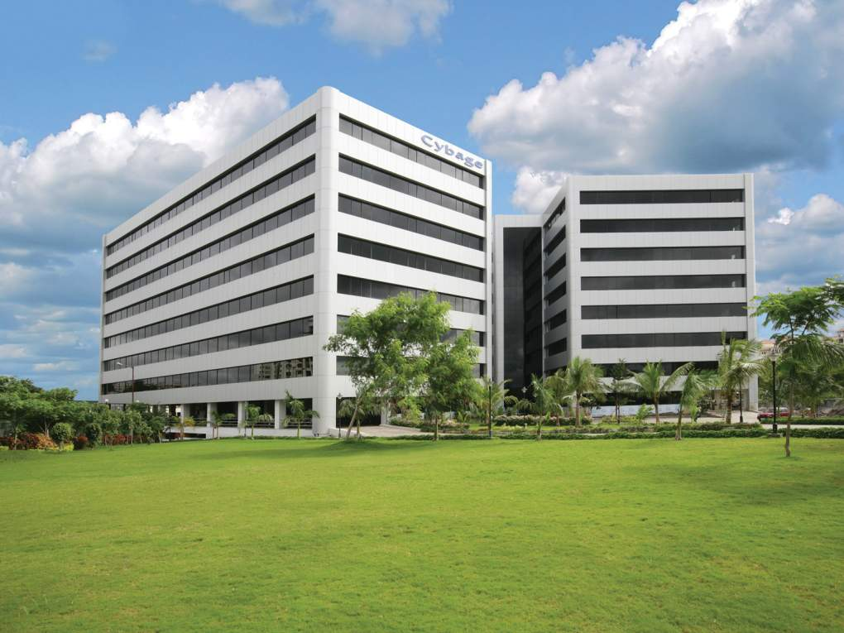

ALM Kickoff- 15 Dec 2015
This document and all its contents contain information from Cybage Software Private Limited which may be privileged, confidential, or otherwise protected from disclosure. The information is intended to be for the addressee(s) only. Any unauthorized disclosure, copy, distribution, or use of the contents of this message is strictly prohibited.
1

Slide 2
Agenda
Objective
Execution Process
Project Plan
Stakeholders
Expectation
Knowledge Retention
Issue Resolution
Risks
Development workflow - Project team
Tools discussion
2

Slide 3
Objective
Implement ALM best practices across projects to accrue its benefits like quality, traceability, visibility, productivity etc.
Result in client satisfaction and confidence in partnering with Cybage.
3

Slide 4

Project selection process
Execution Process
ALM champion/ALM PM /Prj PM
Kickoff meeting
Client consent on ALM received
Gap Assessment
Questionnaire
Discussion
Demo
Project team sign off
Execution
Implementation
Project team sign off
Define solution
Resolving Issue
Support from project Lead(PoC)
Closure (Sign off by project team)
Training
4

Slide 5
Tentative project plan
5

Slide 6
Stakeholders – ALM Team
Name | Designation | Email | Ext. No. | Phone
Rajendra Rakhecha | DM | rajendrar@cybage.com | 8688 | 9998977680
Varghese Mathew | PM | varghesem@cybage.com | 8425 | 9766594425
Vishnu Kant | TL | vishnuk@cybage.com | 8420 | 8237382402
Jithin Raphi | TM | jithinr@cybage.com | 8422 | 9400986697
Puneet Singh | TM | puneetsi@cybage.com | 8419 | 8806266403
Navneet Joshi | TM | navneetjo@cybage.com | 8416 | 9461555597
Rajiv Rai | TM | rajivra@cybage.com | 8430 | 7387824202
6

Slide 7
Stakeholders – Mobile Team
Name | Designation | Email | Phone
Ashutosh Bhonsle | Sr.Project Manager | ashutoshb@cybage.com | 6336
Vitthal Khatpe | SA | vitthalk@cybage.com | 6682
7

Slide 8
Stakeholders – Mchat_Dev Team
Name | Designation | Email | Ext. | Phone
Vijay Rahangdale | DH | vijayrah@cybage.com | 6493 | 7722034016
Smital Petkar | PM | smitalp@cybage.com | 6476 | 9850064684
Harshal Ranpise | SSE / Lead | harshalran@cybage.com | 6644
Gopikrishnan Gunasekaran | QL | gopikrishnang@cybage.com | 6641
8

Slide 9
Expectation
Consent to implement ALM required from client/DM.
Timely information/support to ALM team
Appropriate access for ALM implementation
Project team to retain/build ALM knowledge within project team.
Post implementation - Project team responsible for resolving ALM issues
9

Slide 10
ALM Knowledge Retention
ALM Implementation
ALM Team
ALM Execution
Gap
Assessment
Closure
Support
Training
Project team to retain/build ALM knowledge within project team.
10

Slide 11

Issue Resolution
Resolve
by
ALM issues
Unresolved issues
Project Team
ALM Team
ALM execution
Closure
Post implementation - Project team responsible for resolving ALM issues
11

Slide 12
Risks
Potential Risks | Responsible Person | Mitigation Plan
First project where ALM team and Mobile team working together. | Varghese Mathew Ashutosh Bhonsle | Need to have proper coordination for entire project execution Need to work as per defined scope.
ALM/Mobile team may need to work on proof of concept which may impact schedule. | ALM Team Mobile Team
12

Slide 13
Thank you!
13

